Slide 1


Abhishek
08/11/2023

Slide 2

Outline
Executive Summary
Introduction
Methodology
Results
Conclusion
Appendix

Slide 3
Executive Summary
Methodologies used:
Data collection using API call or web scraping
Data wrangling
EDA with SQL and visualization
Building an interactive map with Folium
Building a dashboard with Plotly Dash
Predictive analytics (classification)
Results obtained:
Exploratory data analysis
Visual analytics
Predictive analytics
Conclusions

Slide 4
Introduction
Project background and context:
Our client SpaceY, would like to bid against SpaceX for a rocket launch. SpaceX, founded by Elon Musk, is currently the leading company in this space. They advertise Falcon 9 rocket launches on their website at a cost of $62million. Other companies provide their cost upwards of $165million each. Much of the savings is because SpaceX can reuse the first stage.
Problems we want to find answers of:
Can we predict if the first landing will be successful?
What factors influence a successful landing?
Is there a machine learning model we can apply to predict?

Slide 5

Section 1

Slide 6
Methodology
Executive Summary
Data collection methodology:
Data was collected using API from SpaceX data and later converted to DataFrame.
Perform data wrangling
Identified the null values and delt with that using mean values.
Perform exploratory data analysis (EDA) using visualization and SQL
Perform interactive visual analytics using Folium and Plotly Dash
Perform predictive analysis using classification models
Used multiple machine learning models and tuned them to get optimum result.

Slide 7
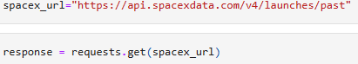
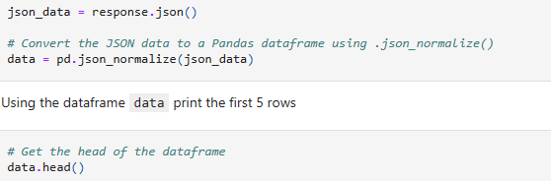
Data Collection – SpaceX API
Data was collected using SpaceX web API.
Used URL to get Data
Then used response method to get data.
After getting the data that data converted to pandas DataFrame so that we can use that data in our project.
For more please refer to this GitHub file:
IBMCapstoneFinalProject/week 1.1-jupyter-labs-spacex-data-collection-api.ipynb at main · Abhishek7415/IBMCapstoneFinalProject (github.com)

Slide 8
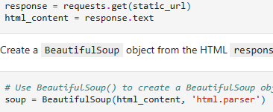
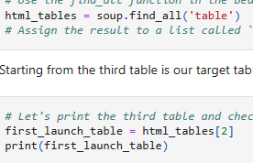
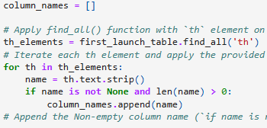
Data Collection - Scraping
Web Scraping
Created the ‘http response’ using get method.
Then converted that response text to ‘Soup’ object using BeautifulSoup.
Then found all the tables using ‘find_all’ method from soup.
Converted that collected data to pandas DataFrame.
For more please refer this Github file:
IBMCapstoneFinalProject/week 1.2-jupyter-labs-webscraping.ipynb at main · Abhishek7415/IBMCapstoneFinalProject (github.com)

Slide 9
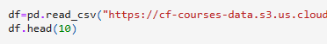
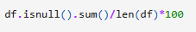
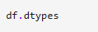
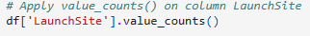
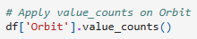
Data Wrangling
Data was loaded and then turned into pandas DataFrame.
Found the percentage of null values from the data, data types.
Calculated the number of launches on each sites and number of occurrence of each orbit.
Manipulated the data for landing outcomes as for successful landing it was “1” as “0” for unsuccessful landing.
For more please refer to GitHub file:
IBMCapstoneFinalProject/week 1.3-labs-jupyter-spacex-Data wrangling.ipynb at main · Abhishek7415/IBMCapstoneFinalProject (github.com)

Slide 10
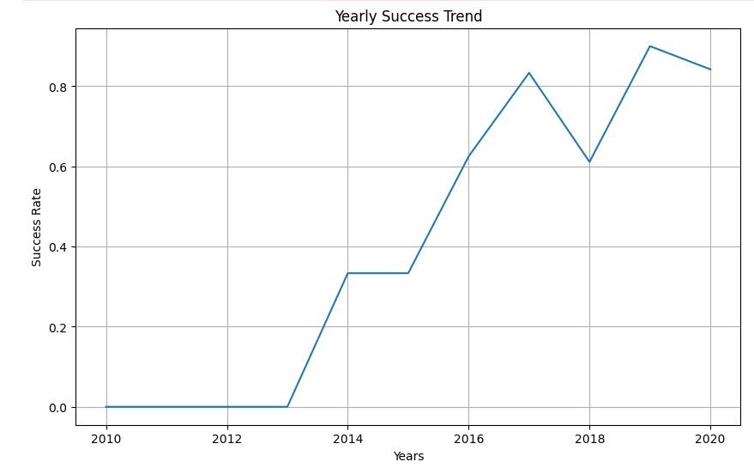
EDA with Data Visualization
To predict parameters for successful landing following graphs were created:
Scatter chart on Flight Number vs. Payload
Scatter chart on Flight Number vs. Launch Site
Scatter chart on Flight Number vs. Orbit Type
Scatter chart on Payload vs. Orbit Type
Scatter chart on Payload vs. Launch Site
Bar chart to represent Success Rate per Orbit Type
Line chart to represent Yearly Success trend
For more refer to this GitHub file:
IBMCapstoneFinalProject/week 2.2-IBM-DS0321EN-SkillsNetwork_labs_module_2_jupyter-labs-eda-dataviz.ipynb.jupyterlite.ipynb at main · Abhishek7415/IBMCapstoneFinalProject (github.com)

Slide 11
EDA with SQL
The following SQL queries were performed for project.
Identify all unique launch sites
Identify all launch sites beginning with ‘CCA’
Calculate the total payload mass carried by boosters launched by NASA (CRS)
Calculate average payload mass carried by booster version F9 v1.1
Identify earliest date when first successful landing in ground pad was achieved
List all boosters which have success in drone ship with payload mass between 4000 to 6000
Calculate total number of successful vs. non-successful outcomes
List all boosters which have the max payload mass
Display all months where landing failed for drone ships in 2015
Rank the count of landing outcomes between 2010-06-04 and 2017-03-20
For more please refer to this GitHub file:
IBMCapstoneFinalProject/week 2.1-jupyter-labs-eda-sql-coursera_sqllite.ipynb at main · Abhishek7415/IBMCapstoneFinalProject (github.com)

Slide 12
Build an Interactive Map with Folium
A Folium site map has been created in order to geographically explore the physical location of the launch sites. This will help to determine whether the geographic location contributes to a successful landing. The following objects have been added to the site map.
Markers were placed on the map using the mentioned sites’ latitudes and longitudes
A blue circle to highlight the NASA Johnson Space center
Orange circles for all launch sites with name labels
Green and red pop-up markers to differentiate between successful (green) and failed (red) landings at each launch site.
Plot lines to highlight the proximity of the launch sites to some landmarks
Plot lines with distance displayed to the nearest coast or highway
Plot lines with the distance displayed to the nearest city, airport or railway station
For more please refer this GitHub file:
IBMCapstoneFinalProject/week 3.1-IBM-DS0321EN-SkillsNetwork_labs_module_3_lab_jupyter_launch_site_location.jupyterlite.ipynb at main · Abhishek7415/IBMCapstoneFinalProject (github.com)

Slide 13
Build a Dashboard with Plotly Dash
A dashboard has been created to allow the client to view dynamic data on successful vs. failed landings per launch site. It also provides a scatter chart on payload mass which can be analyzed to check whether it contributes to a successful landing. The following features / charts are in the dashboard. The dashboard can be further enhanced should the client require it.
Dropdown list showing all unique launch sites as well as ‘All sites’
Pie chart showing the % rate of successful vs. failed launches of the selected dropdown option
Range slider for payload mass range to allow users to select the payload range
Scatter chart to show the correlation between payload and success rate by booster version
For more please refer to this GitHub file:
IBMCapstoneFinalProject/week 3.2-spacex_dash_app.py at main · Abhishek7415/IBMCapstoneFinalProject (github.com)

Slide 14
Predictive Analysis (Classification)
Summarize how you built, evaluated, improved, and found the best performing classification model
You need present your model development process using key phrases and flowchart
Add the GitHub URL of your completed predictive analysis lab, as an external reference and peer-review purpose

Slide 15
Results
Exploratory data analysis results
Interactive analytics demo in screenshots
Predictive analysis results

Slide 16

Section 2

Slide 17
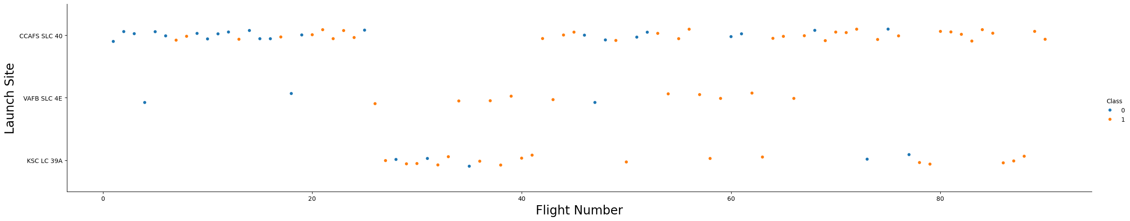
Flight Number vs. Launch Site
Scatter plot of Flight Number vs. Launch Site
We can see that CCAFS SLC 40 have most failure rate than other two launch sites as we have most of launch trials from this site.
VAFB SLC 4E have least number of launches but most of them are successful.

Slide 18
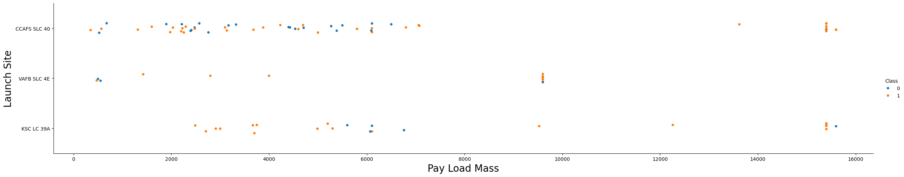
Payload vs. Launch Site
Scatter plot of Payload vs. Launch Site
VAFB SLC 4E site launches rockets less than 10000kg
CCAFS SLC 40 and KSL LC 39A sites have launches heaviest rockets also

Slide 19
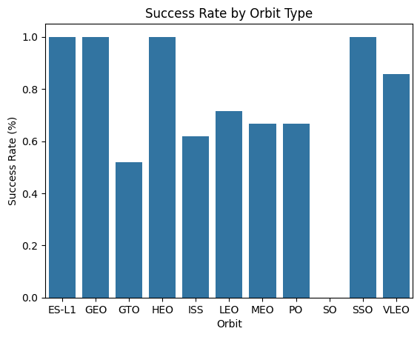
Success Rate vs. Orbit Type
Bar chart for the success rate of each orbit type
Orbit SO have zero chances of success rate.
ES-L1, GEO, HEO, SSO have mostly successful chances.

Slide 20
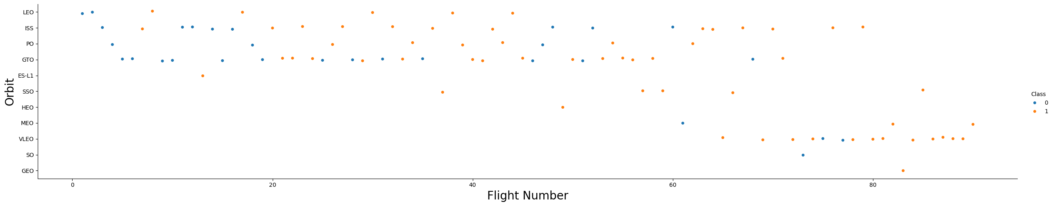
Flight Number vs. Orbit Type
Show a scatter point of Flight number vs. Orbit type
GEO have only one flight and it was successful
Despite of SO have no success there are not enough trails to support the claim of failure of success rate.
GTO have maximum number of flights.

Slide 21
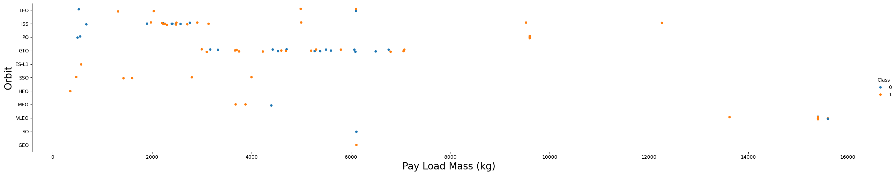
Payload vs. Orbit Type
Scatter point of payload vs. orbit type.
Mostly launched rockets are less than 8000kg.
SSO have maximum success rate.
The heaviest rocket launched was a failure in VLEO orbit.

Slide 22
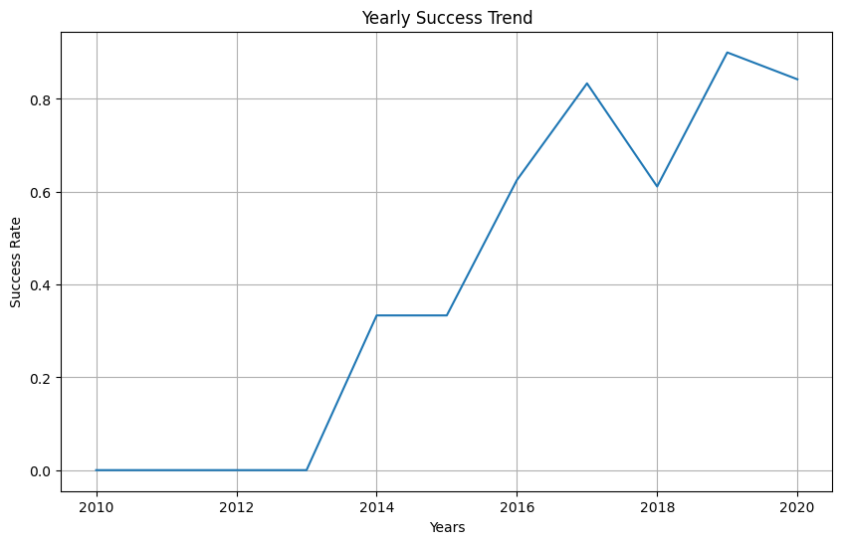
Launch Success Yearly Trend
Line chart of yearly average success rate
As we can see over the year till 2013 there was no success.
Then success emerged all of a sudden.
There was a drop in success rate in 2018.

Slide 23
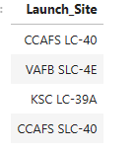
All Launch Site Names
Unique launch sites
There were only four launch sites
Distinct method was used to retrieve those names

Slide 24
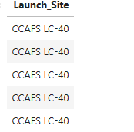
Launch Site Names Begin with 'CCA'
5 records where launch sites begin with `CCA`.
These are the sites which are starting with CCA.
We used like “CCA%%” method to find these names.

Slide 25
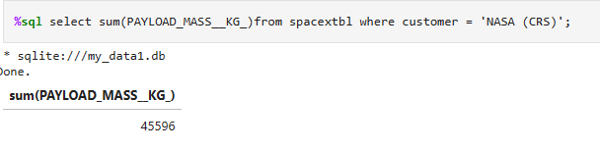
Total Payload Mass
Calculate the total payload carried by boosters from NASA
The total payload mass was 45596kg upto yet.

Slide 26
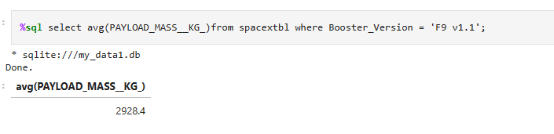
Average Payload Mass by F9 v1.1
Average payload mass carried by booster version F9 v1.1
Average Pay Load Mass is 2928.4kg.

Slide 27
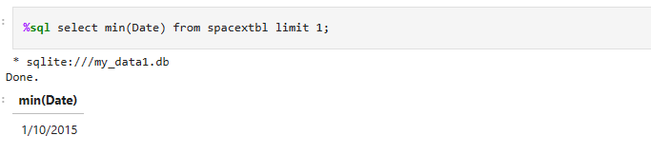
First Successful Ground Landing Date
First successful landing outcome on ground pad
First successful landing was on 1/10/2015.
We used min method to extract first date.

Slide 28
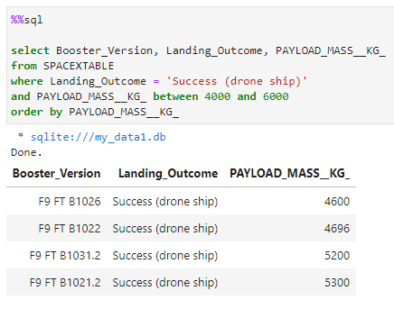
Successful Drone Ship Landing with Payload between 4000 and 6000
Names of boosters which have successfully landed on drone ship and had payload mass greater than 4000 but less than 6000

Slide 29
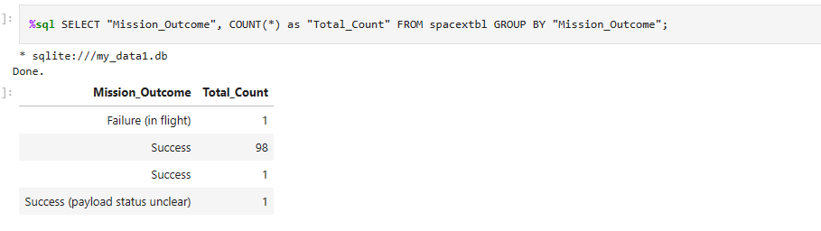
Total Number of Successful and Failure Mission Outcomes
Total number of successful and failure mission outcomes

Slide 30
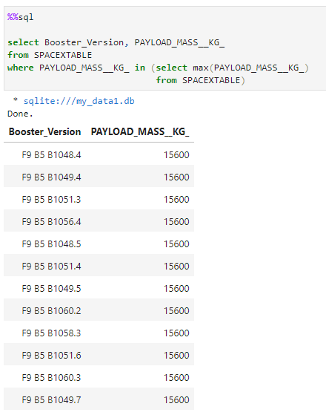
Boosters Carried Maximum Payload
Names of the booster which have carried the maximum payload mass
The SUBQUERY contains the query to search for the MAX Payload Mass from the same database table. The subquery limits the results from the outside query.
Here, you can see that the MAX Payload Mass is 15,600 kg. Only Boosters which have carried this weight are outputted by the query.

Slide 31
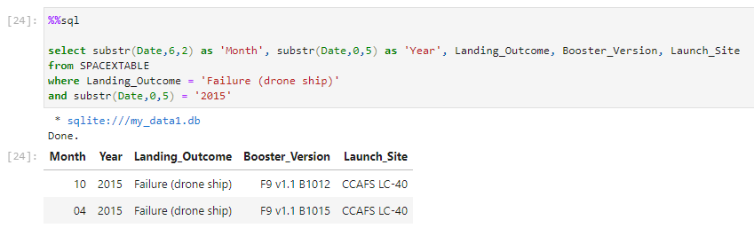
2015 Launch Records
Failed landing_outcomes in drone ship, their booster versions, and launch site names for in year 2015.

Slide 32
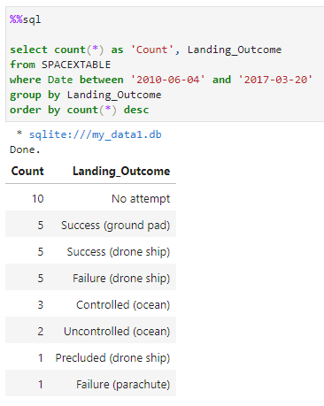
Rank Landing Outcomes Between 2010-06-04 and 2017-03-20
Count of landing outcomes (such as Failure (drone ship) or Success (ground pad)) between the date 2010-06-04 and 2017-03-20, in descending order
COUNT counts the records per group / landing outcome.
WHERE restricts the records to the date range specified.
ORDER BY sorts out the count of landing outcomes in descending order.

Slide 33

Section 3

Slide 34
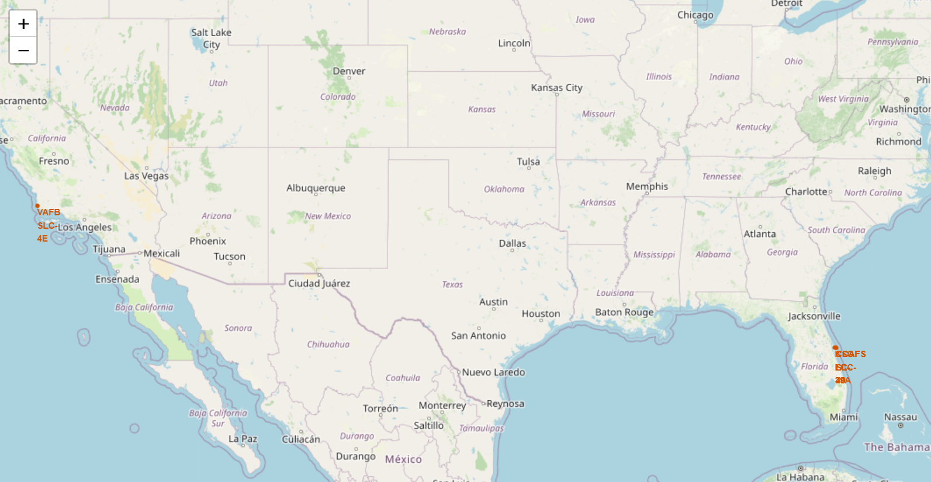
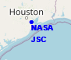
<Folium Map Screenshot 1>

Slide 35
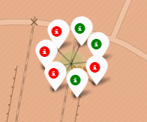
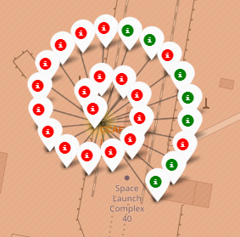
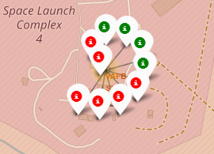
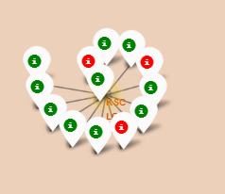
<Folium Map Screenshot 2>
CCAFS SLC-40
CCAFS LC-40
KSC LC-39A
On average, there is a 43.5% success rate across all 3 launch sites in Florida. VAFB, the site in Cali, has a 40% success rate. There’s also more launch attempts from Florida (ratio 23:5). This is because rockets launched closer to the equator can take optimum advantage of the earth’s substantial rotational speed. We can infer that equatorial launches help contribute to a successful landing.

Slide 36
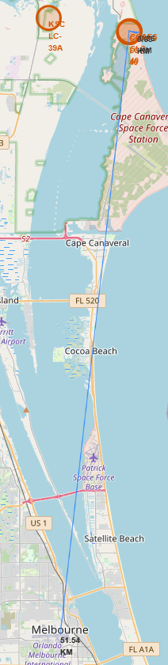
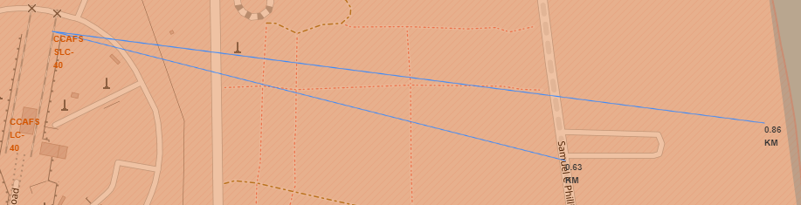
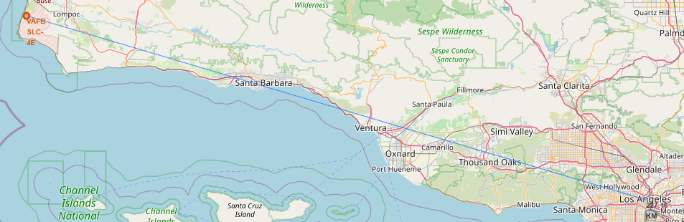
<Folium Map Screenshot 3>

Slide 37

Section 4

Slide 38
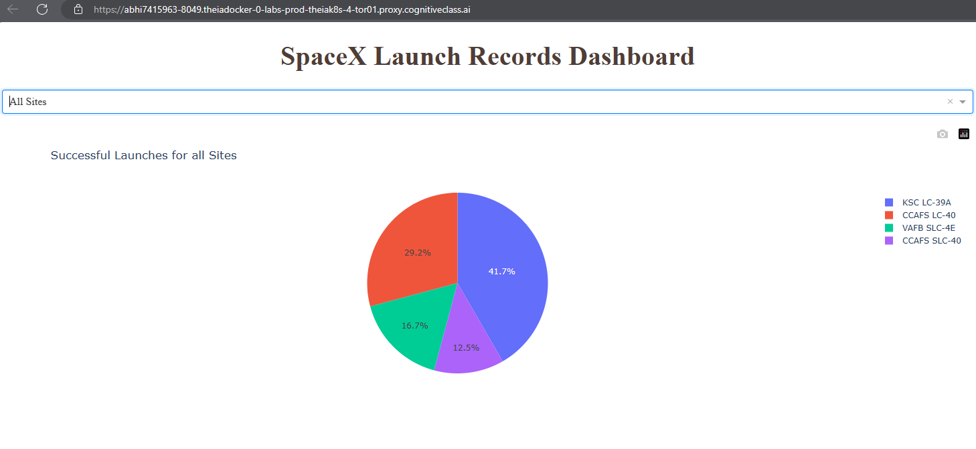
<Dashboard Screenshot 1>
KSC LC-39A has the highest success rate out of all the sites at 41.7%.

Slide 39
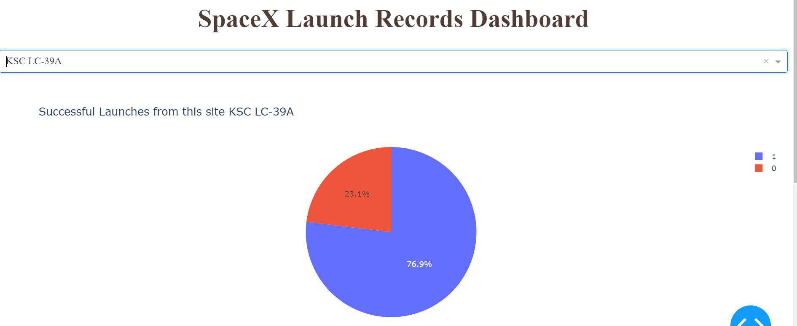
<Dashboard Screenshot 2>

Slide 40
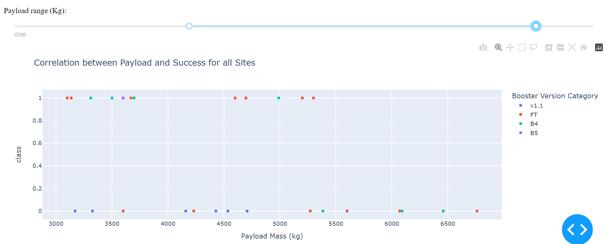
<Dashboard Screenshot 3>

Slide 41

Section 5

Slide 42
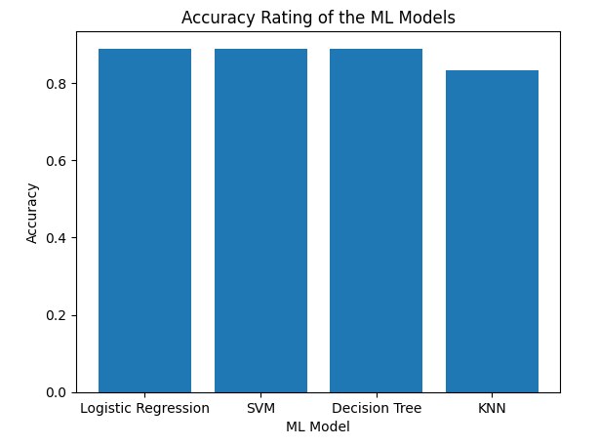
Classification Accuracy
KNN have least accuracy.
Other 3 have same accuracy.
Maybe data is not enough available.

Slide 43
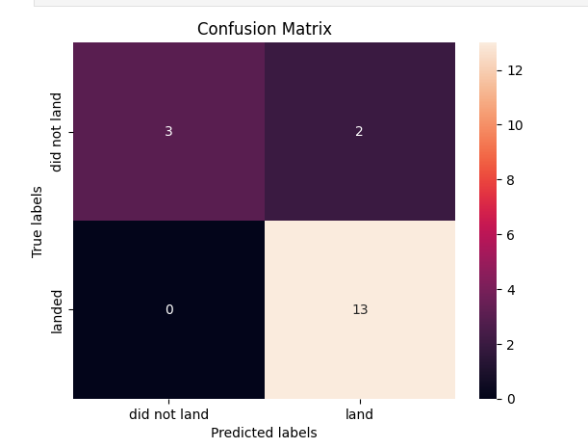
Confusion Matrix
All 3 best performing models have same confusion matrix.

Slide 44
Conclusions
Based on our analyses, we are able to make predictions on whether the first stage can be reused. If the first stage can be reused, this will cost the company less.
We know that launches are more successful when:
Launches happen from KSC LC-39A, with payload masses above 5,500 kg.
We apply the lessons learned from the previous years as exhibited by the sharp increase yearly.
Launches in orbits ES-L1, GEO, HEO and SSO.
Launched in a site closer to the equator.
We created 4 models. Based on our initial evaluation, all 4 models: logistic regression, KNN, decision tree and SVM, can all be used to predict but we can loose KNN, with the possibility that we can train and test better with a bigger sample data.

Slide 45
Appendix
Include any relevant assets like Python code snippets, SQL queries, charts, Notebook outputs, or data sets that you may have created during this project

Slide 46


